Slide 1


CAPSTONE PROJECT
(Shop For Home)
SPRINT 1
Submitted by:
Rajnish Anand | 18bcs3113@cuchd.in | Group c1
Lakshmi Bhavya Annapureddy | bhavyaannapureddy@gmail.com
Vivek Vilas Salunke | viveksalunke.me@gmail.com
Pinnamaraju Sai Poojitha | poojapinnamaraju2001@gmail.com
Under the Guidance of
NEERAJ KUMAR KHERIA

Slide 2
Problem Description
ShopForHome is a popular Store in the market for shopping the home décor stuff . Due to Covid 19 all the offline shopping stopped. So, the store wants to move to the cloud platforms and wants their own web application.
User-Requirements:
1. As a user I should be able to login, Logout and Register into the application.
2. As a user I should be able to see the products in different categories.
3. As a user I should be able to sort the products.
4. As a user I should be able to add the products into the shopping cart.
5. As a user I should be able to increase or decrease the quantity added in the cart.
6. As a user I should be able to add “n” number of products in the cart.
7. As a user I should be able to get the Wishlist option where I can add those products which I want but don’t want to order now
8. As a user I should get different discount coupon

Slide 3
Admin-Requirements:
1. As an Admin I should be able to login, Logout and Register into the application.
2. As an Admin I should be able to perform CRUD on Users.
3. As an Admin I should be able to Perform CRUD on the products.
4. As an Admin I should be able to get bulk upload option to upload a csv for products details
5. As an Admin I should be able to get the stocks.
6. As an Admin I should be able to mail if any stock is less than 10.
7. As an Admin I should be able to get the sales report of a specific duration.
8. As an Admin I should be able to set of users

Slide 4
ABSTRACT
1- Shop For Home is a popular Store in the market for shopping the home décor stuff .Due to Covid 19 all the offline shopping stopped. So, the store wants to move to the online platforms and wants the own web application.
2- Consumers find a product of interest by visiting the website of the retailer directly or by searching among alternative vendors using a shopping search engine, which displays the same products availability and pricing at different e-retailers.
3- Users can login to the website to shop the products for home decoration and It has the features of add to cart ,wishlist and make orders from home
4-When an online store is set up to enable businesses to buy from another businesses, the process is called business- to-business (B2B) online shopping.
5- Typical online store enables the customer to browse the firms range of products and services

Slide 5
INTRODUCTION
This project Shop for Home has been developed in Angular, Java Spring Boot and POSTGRESQL.
The Shop for Home project is an application which is based on managing the Home-decor and sell the household items online.
The main purpose for developing this project in Angular and Java Spring Boot is to manage all the details about home decor item, home decor category, company, order, sales etc.
There are two categories of user available in this project. First one is admin and second one is user. Admin can add home-décor item category and can also manage the sales details.
This Angular project very helpful for maintaining the sales activity in household item. In this project customer can see the details of home decoration item category etc. Only Admin can edit or delete the details of Home

Slide 6
SPRINT 1- OBJECTIVES
1.Create git repository
2.Create database schema (all tables along with their relationships)
3.Create entities in Spring
4.Create Microservice based structure.
5.CRUD on User and Products
6.Create an eCommerce Template in Angular (Static only) to hold images and products lists.
7.Develop Search Functionality in Angular
8. 8.Bulk upload implementation.

Slide 7
SPRINT 2- OBJECTIVES
1. Cart option.
2. Stock and Sales reports
3. Create Data Transfer objects
4. Create repository
5. Create Service layer logic
6. Create Controller to direct rest api
7. Create Discount Microservice

Slide 8





TECHNOLOGY USED

Slide 9
TECHNOLOGIES REQUIRED
HTML
CSS
JavaScript
Java Spring Boot
SQL
Angular
Visual Studio Code-(VSS)
Eclipse IDE/STS
Postgresql
We have developed this project using the below technology

Slide 10
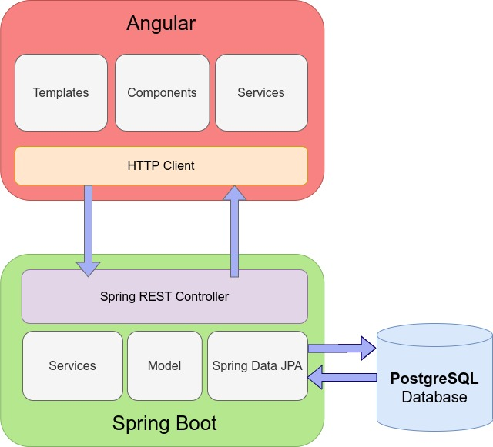

Slide 11
PROJECT OVERVIEW
Shop From Home
User Login
Resister
Login Successfully
API
Authentication
Credential's mismatch
Search
Checkout
Wishlist
Cart
DB
External Api

Slide 12
Visual Studio Code
Open Visual Studio Code
Files -> open project -> locate the directory where you extracted the project and select the frontend folder
• Open terminal
• Then type npm install
• After that type ng serve
• After the successful compiling you got this link in terminal http://localhost:4200/ **
• Open this link in any browser

Slide 13
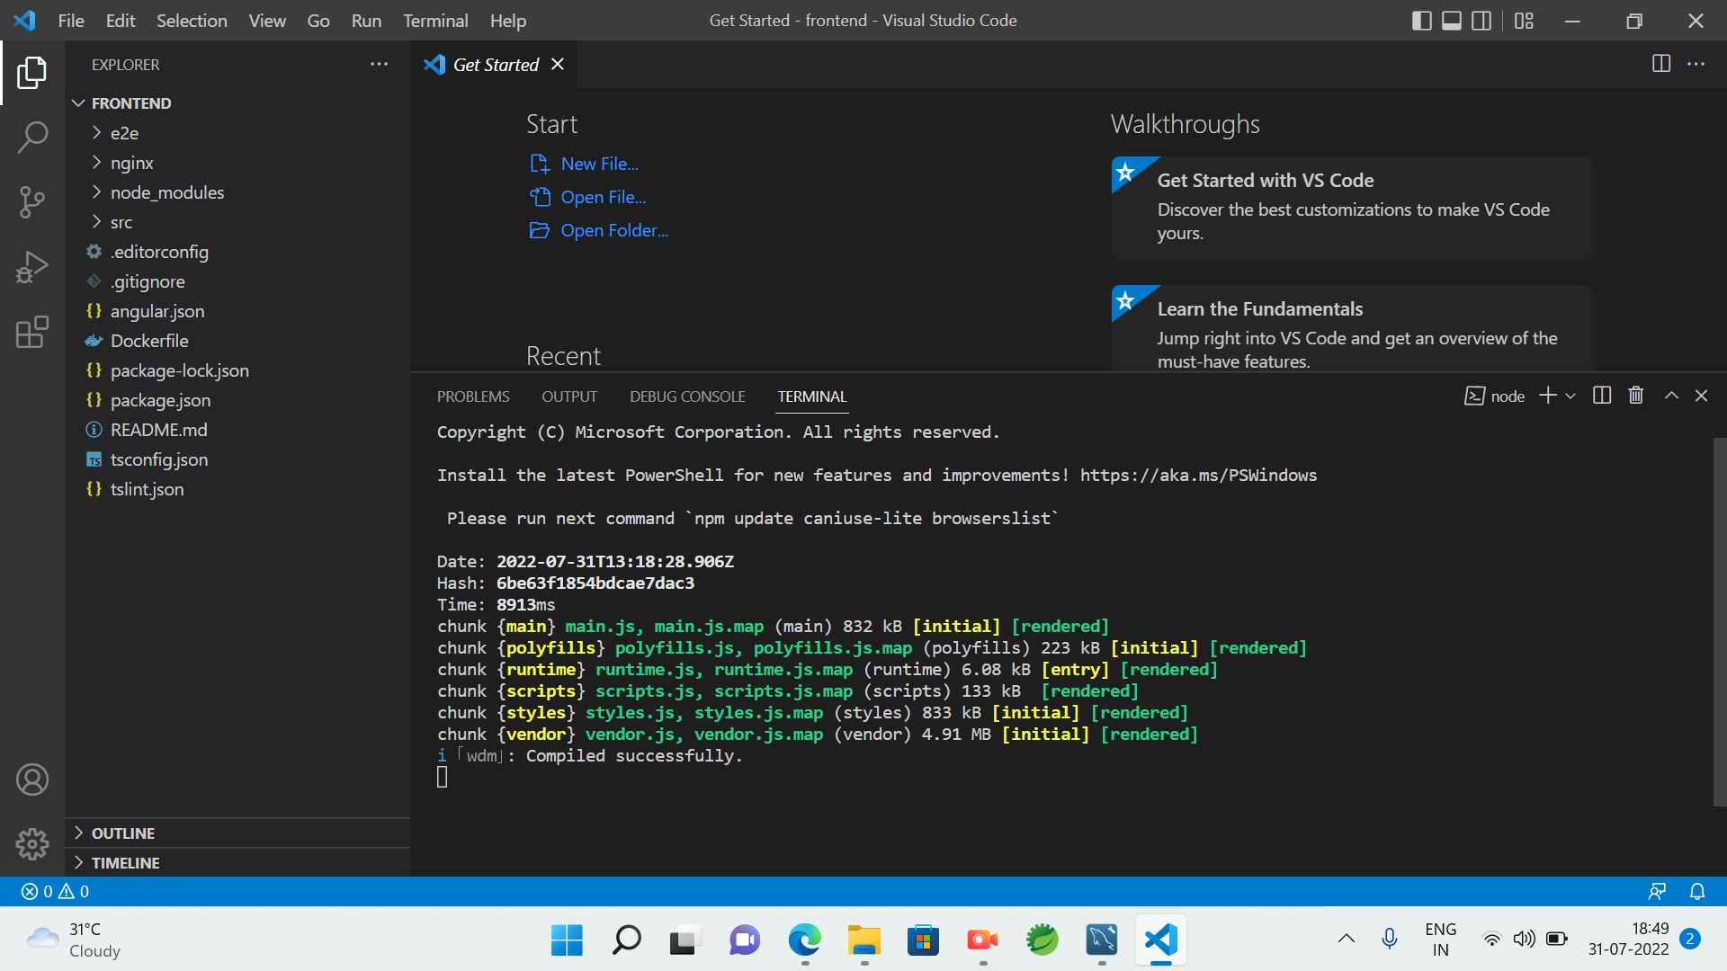
Front End

Slide 14
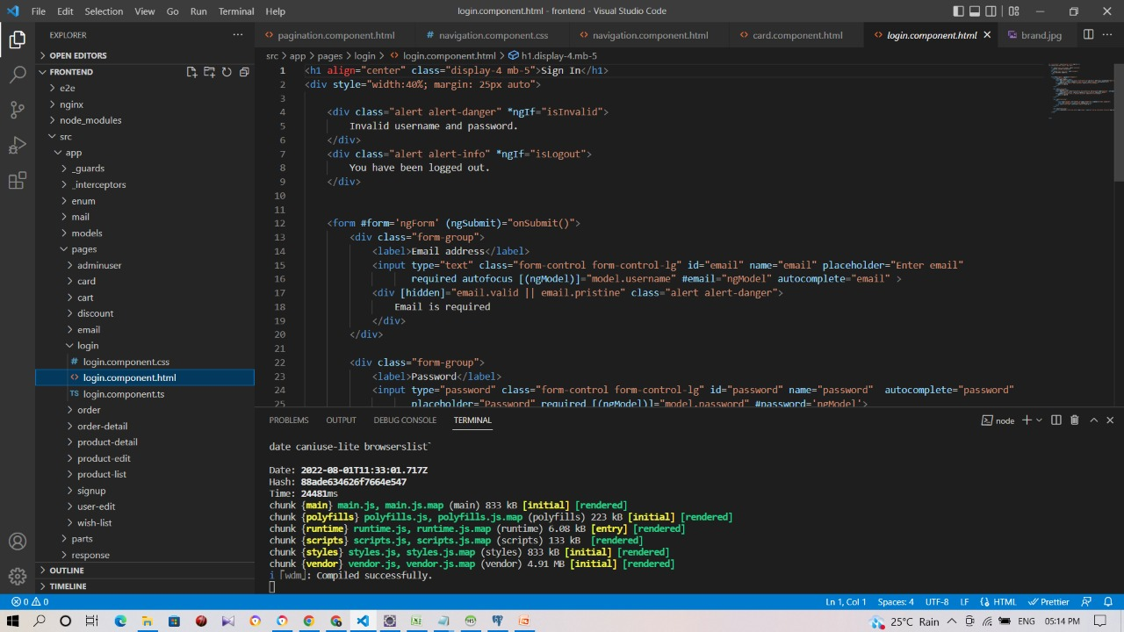

Slide 15
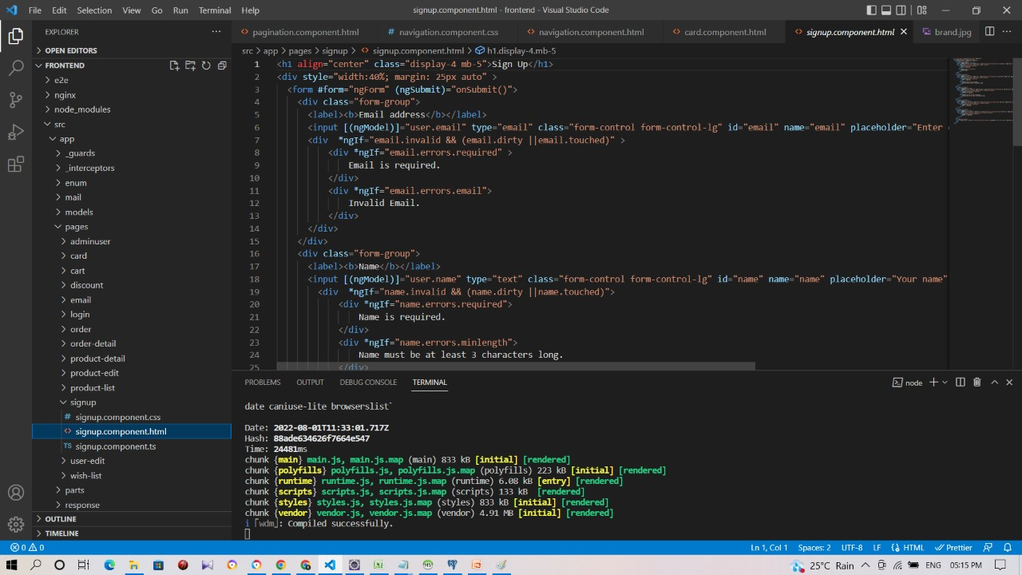

Slide 16
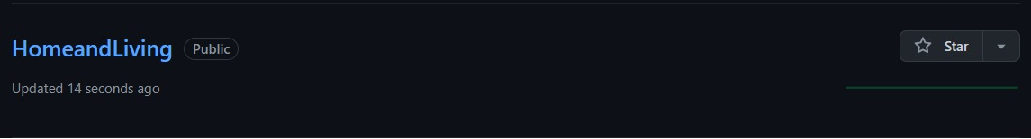
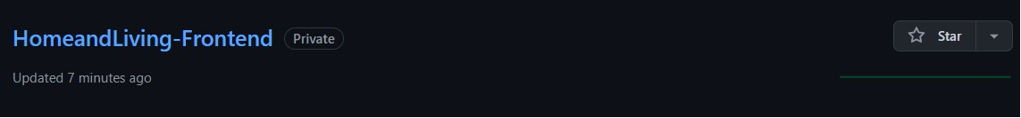
GIT REPOSITORY

Slide 17
User Login Flow Chart
User Login
Home
Login
Register
Dashboard
Cart Option
WishList
S
e
a
r
ch
the
Increase/decr
Check
Add
Product
ease
out
product
Details
product
Quantity
into
WishList

Slide 18
POSTGRESQL
create Database and add required tables
Install postgresSQL
After installation search PgAdmin in your computer
Open that PgAdmin and create the database as homedecor or any other but make sure to declare the same database name in application file
Open this query editor and You can run the query from eshop1.sql file.
Run the query.

Slide 19
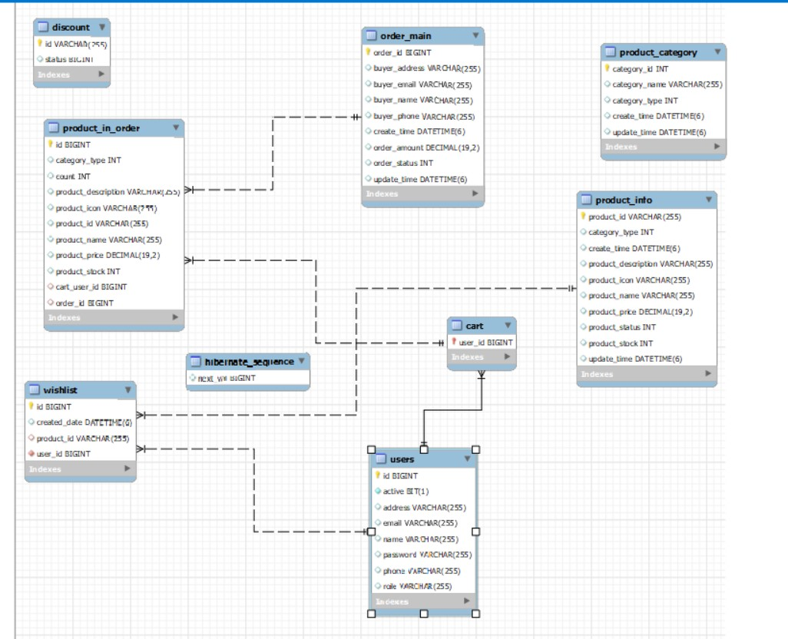
DATABASE SCHEMA

Slide 20
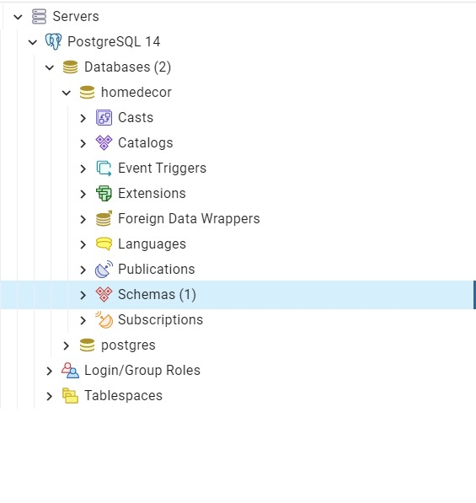

Slide 21
ENTITIES
Entities Classes are used to initialize the variables and make a model format for table
User
Product-Info
Wishlist
Product order
Product category
discount
cart

Slide 22
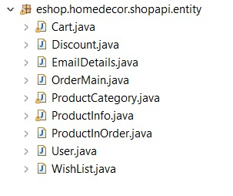

Slide 23
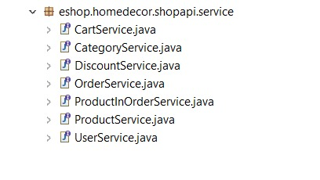
MICRO SERVICE BASED STRUCTURE

Slide 24
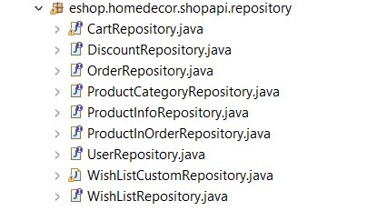
CRUD ON USERS AND PRODUCTS

Slide 25
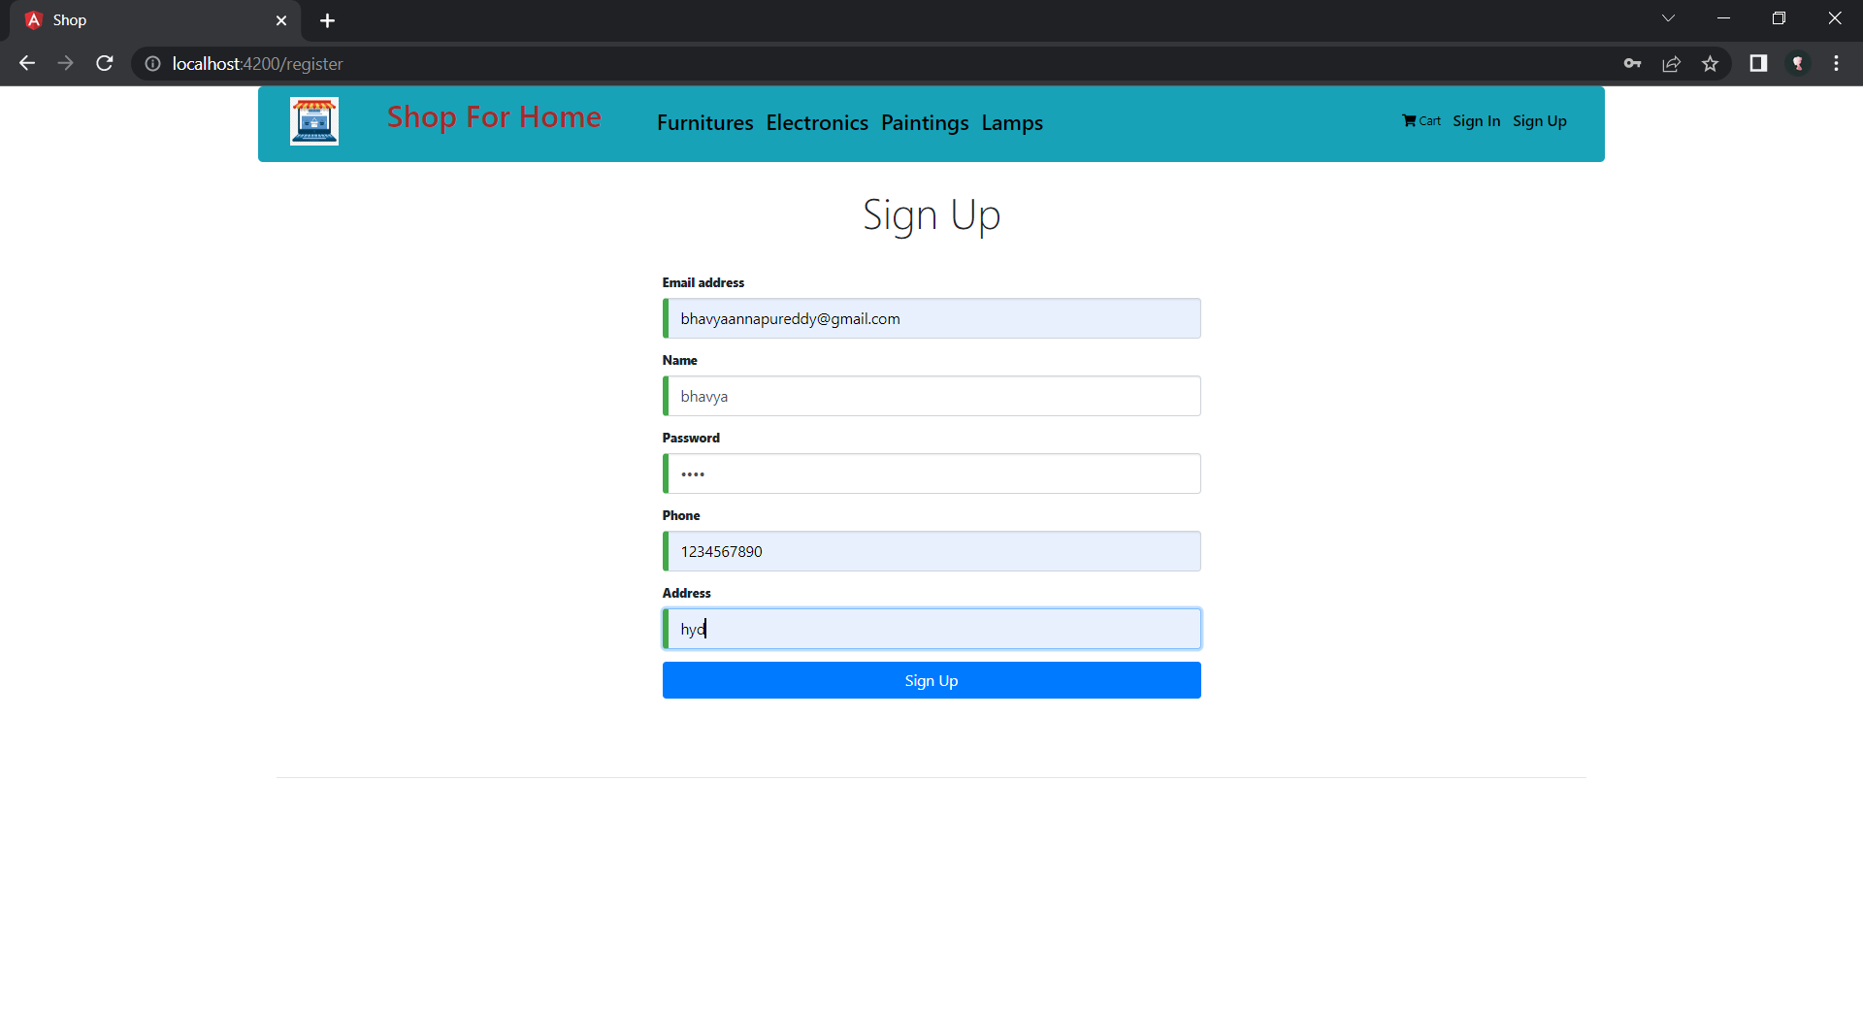
ECOMMERCE TEMPLATE

Slide 26
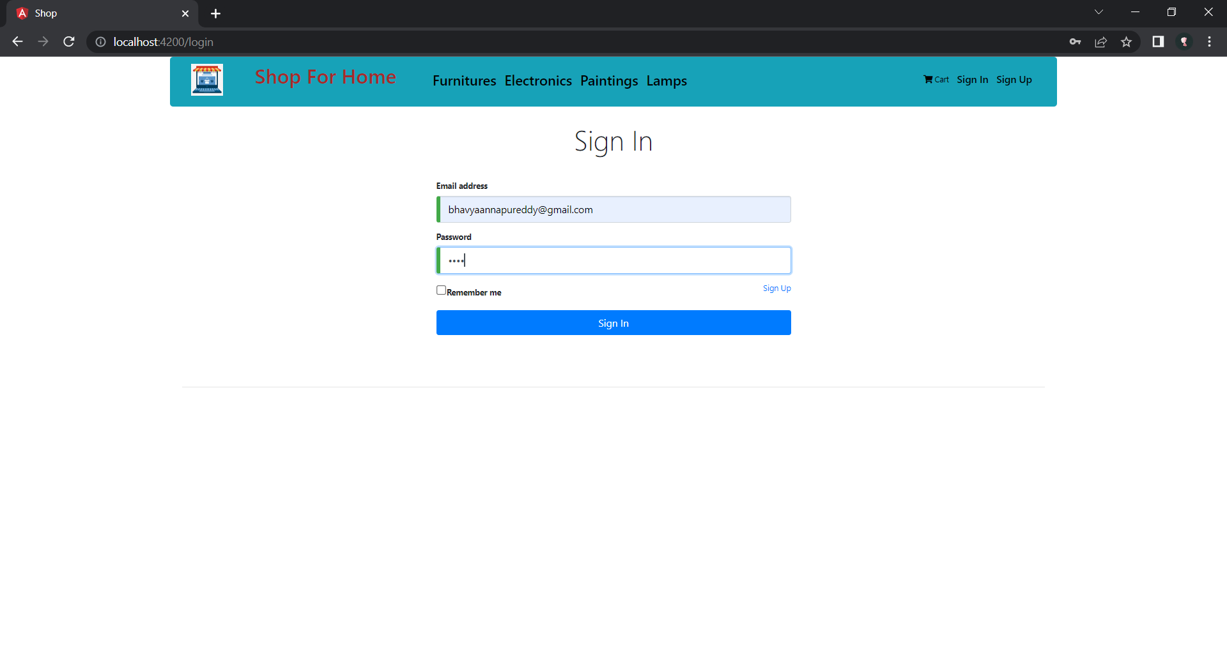
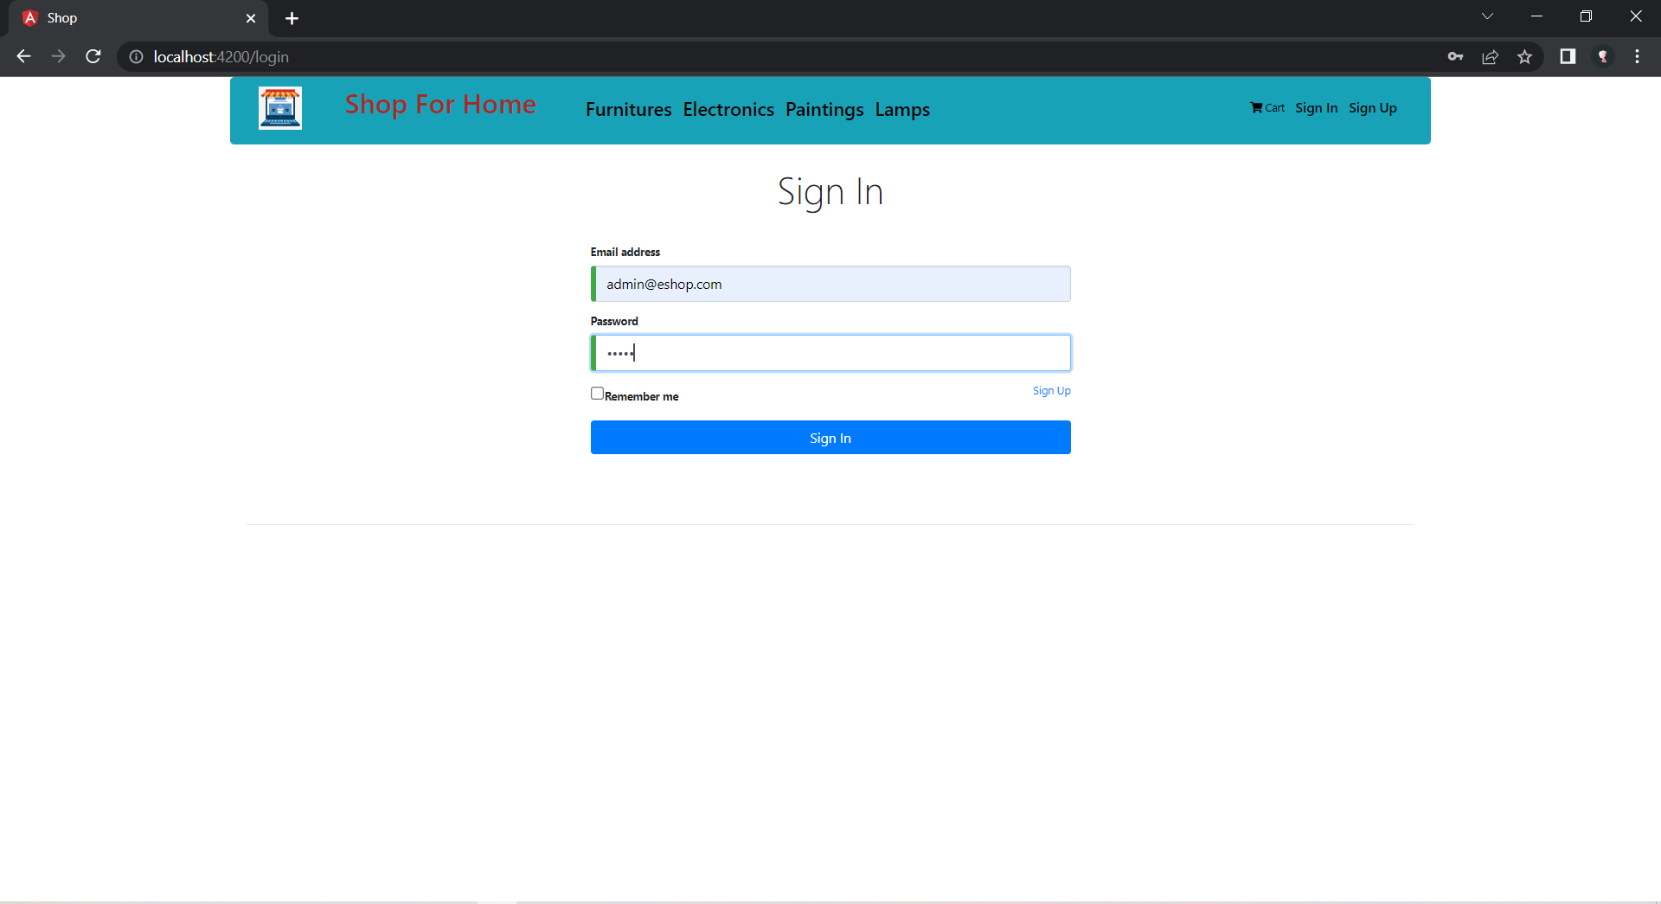

Slide 27
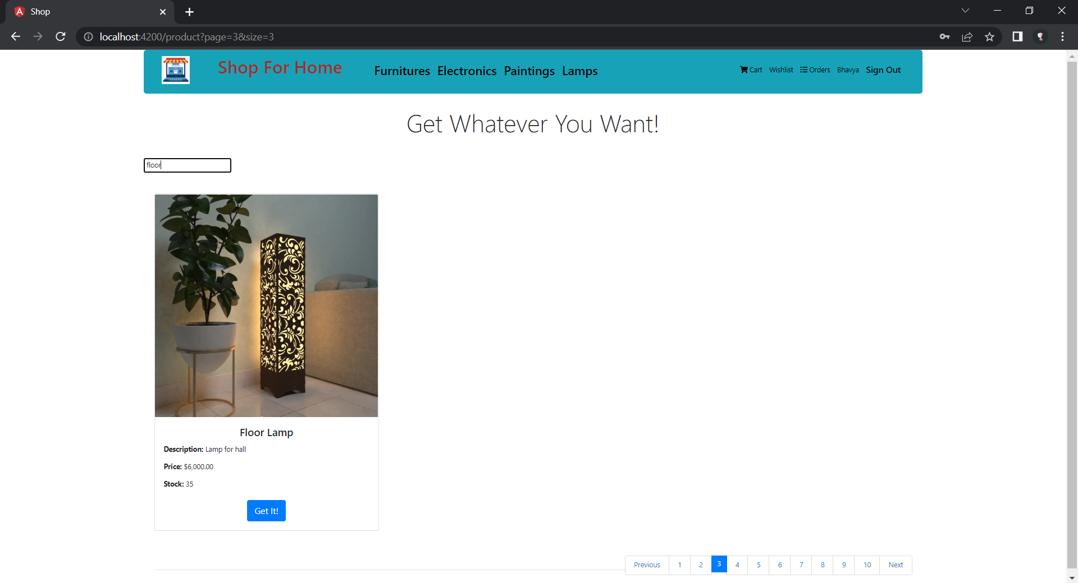
SEARCH FUNCTIONALITY

Slide 28
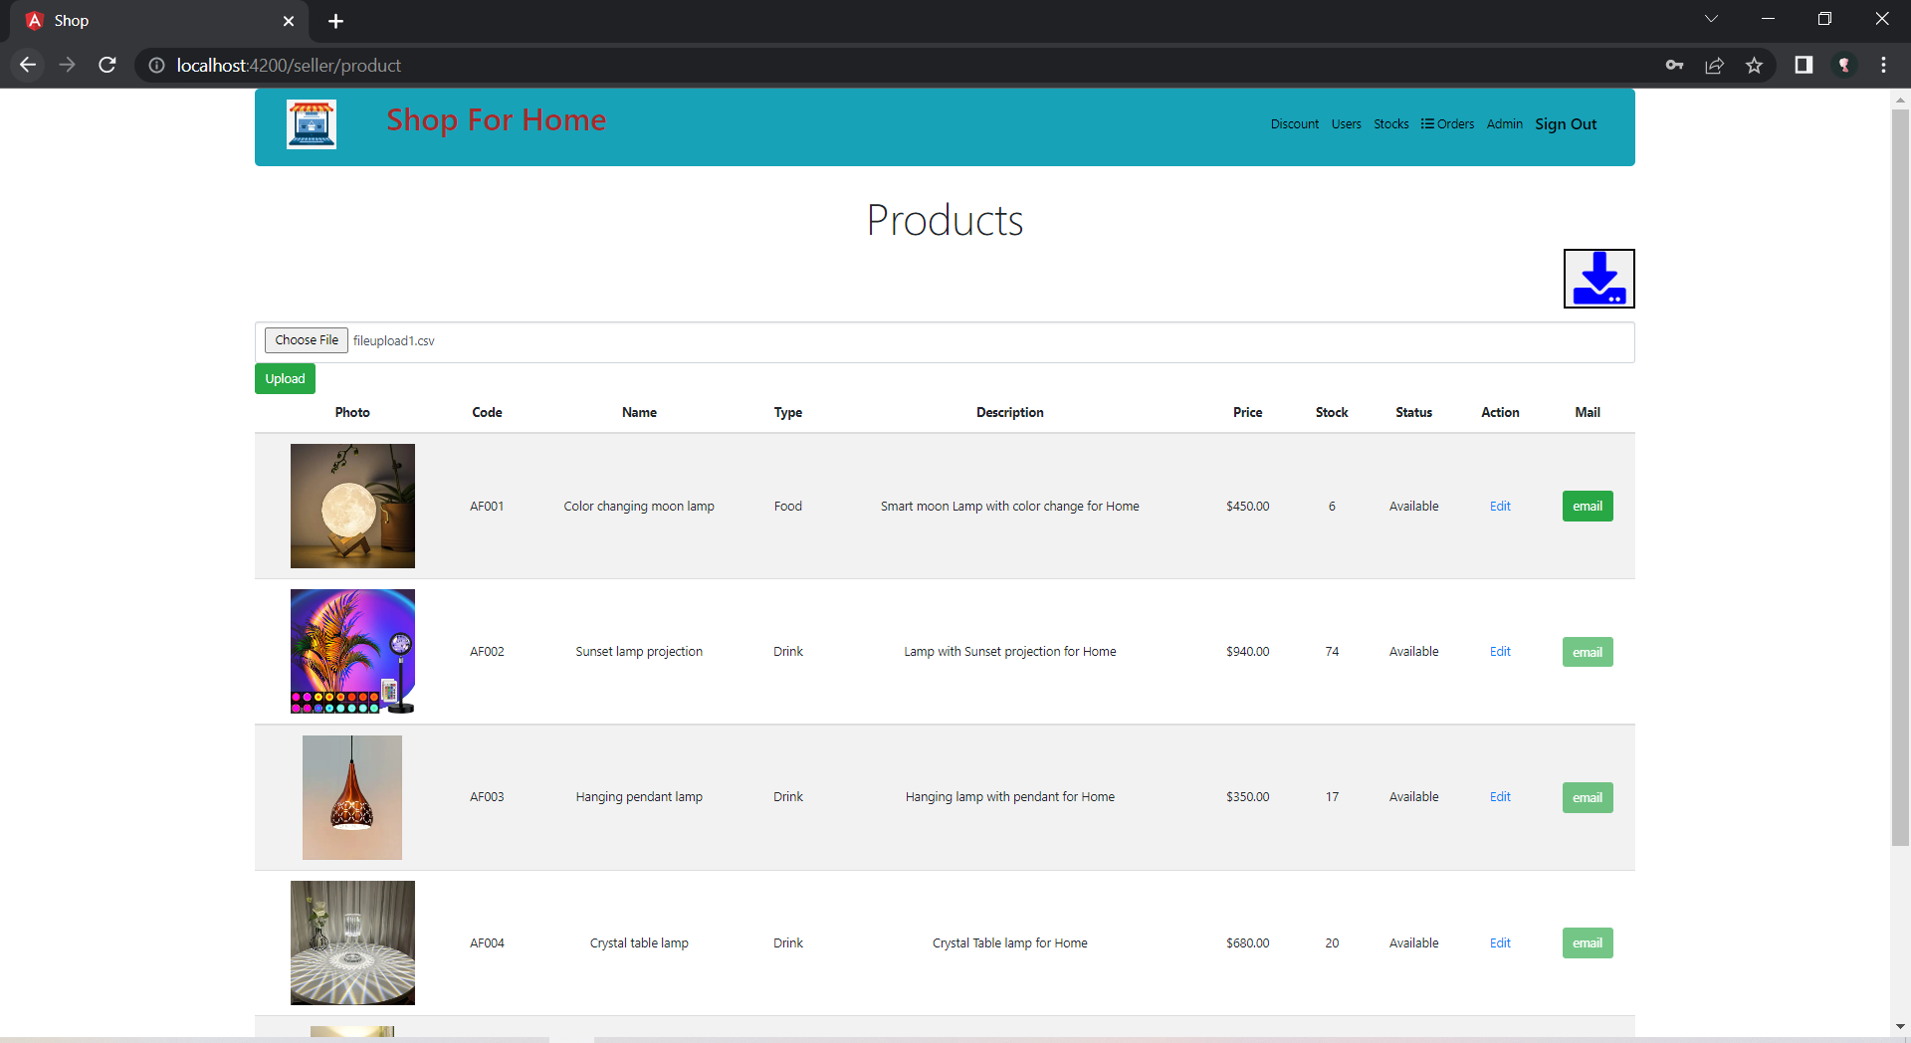
BULK IMPLEMENTATION

Slide 29
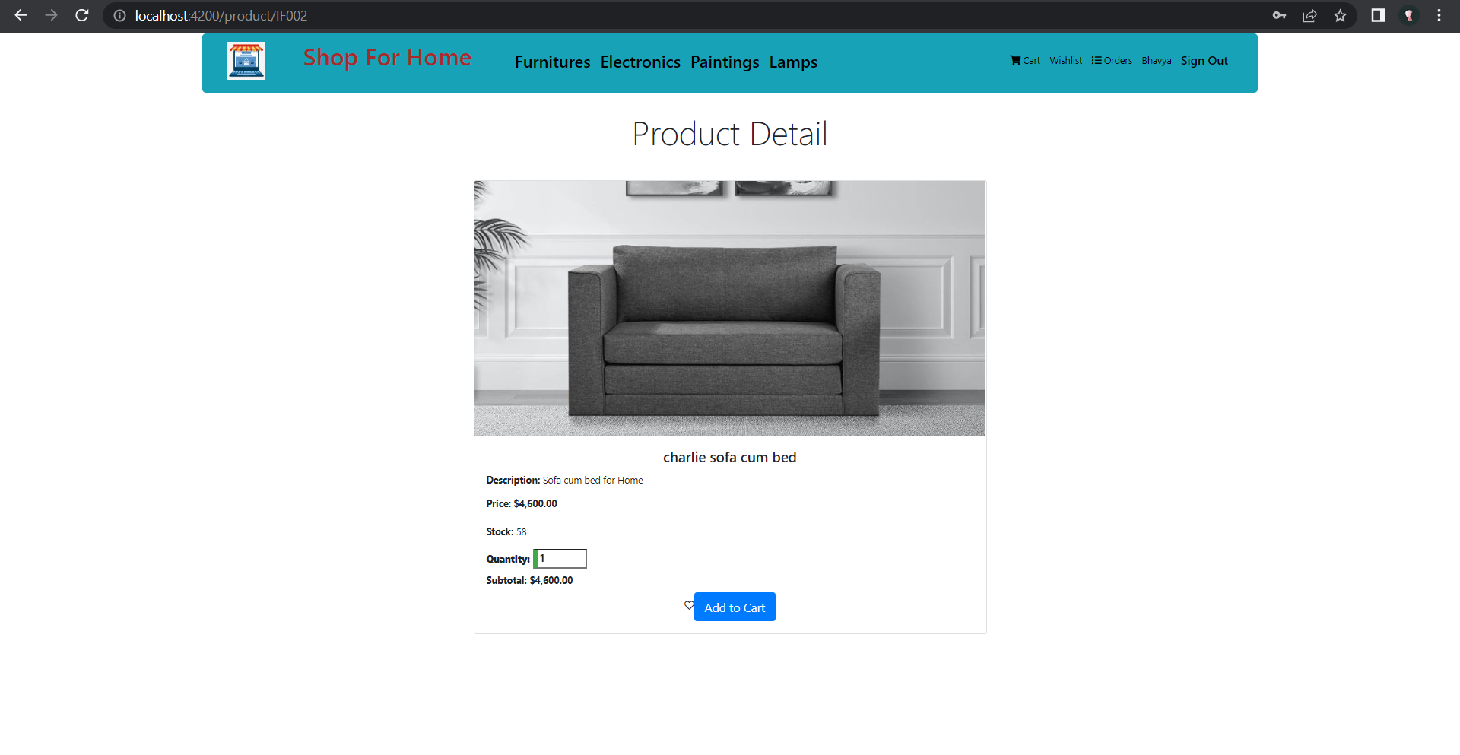
CART OPTION

Slide 30
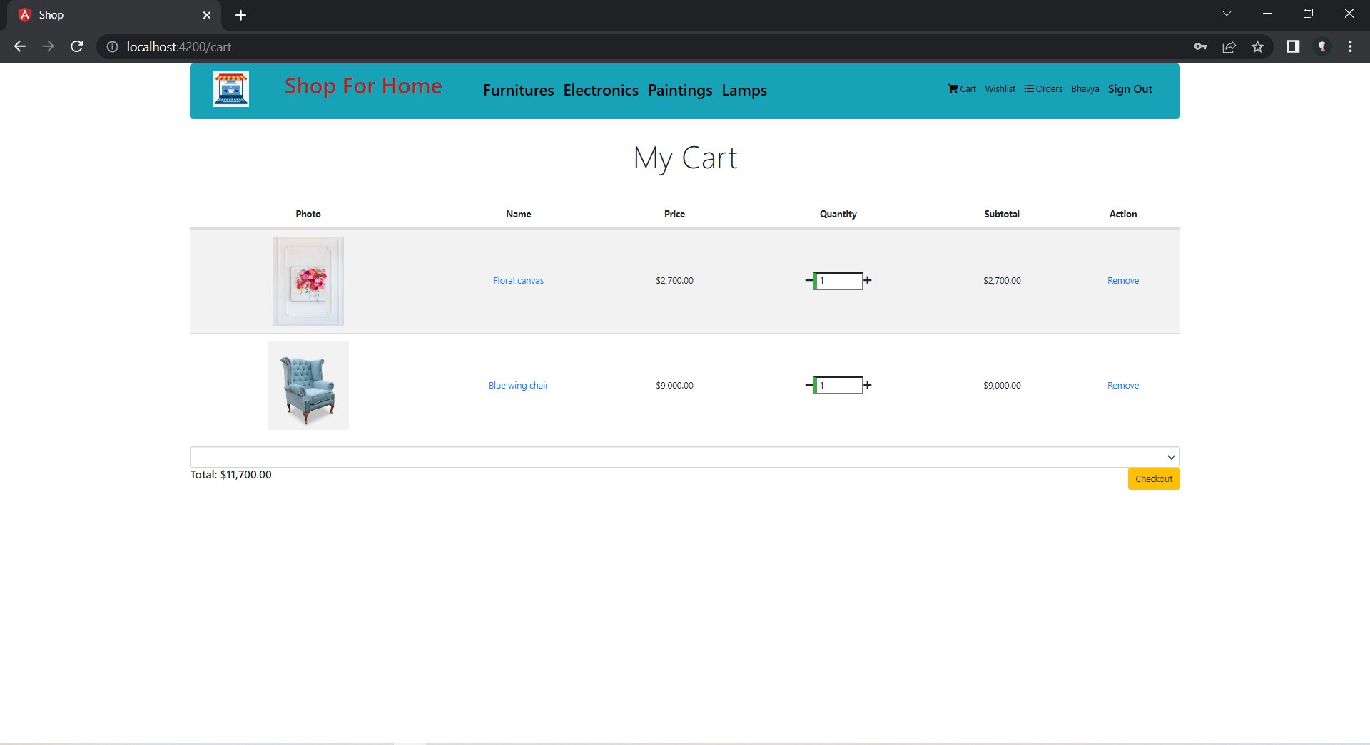

Slide 31
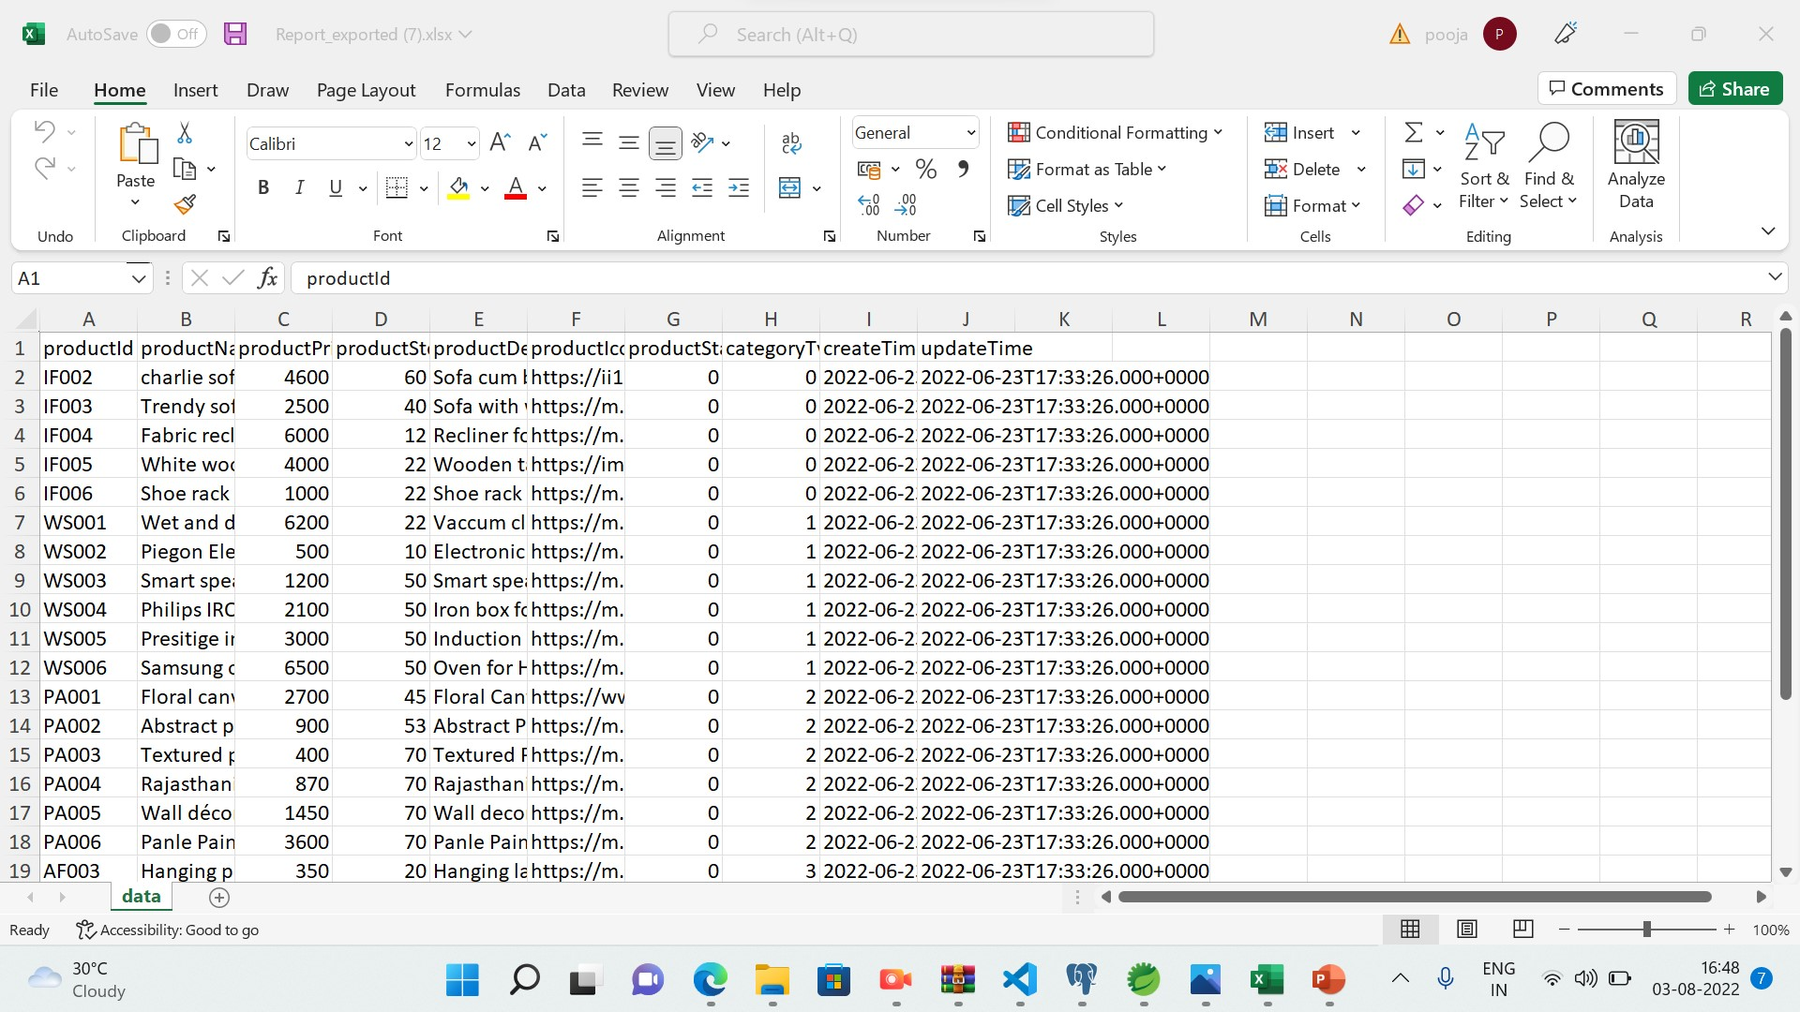
STOCKS AND SALES REPORT

Slide 32
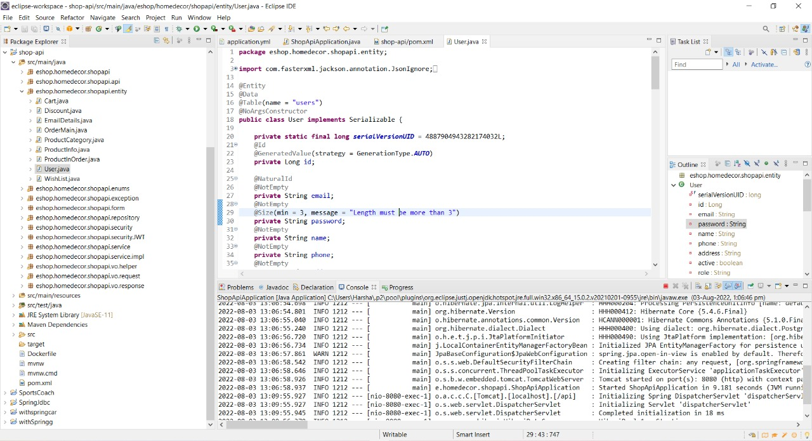
CREATING DATA TRANSFER OBJECTIVES

Slide 33
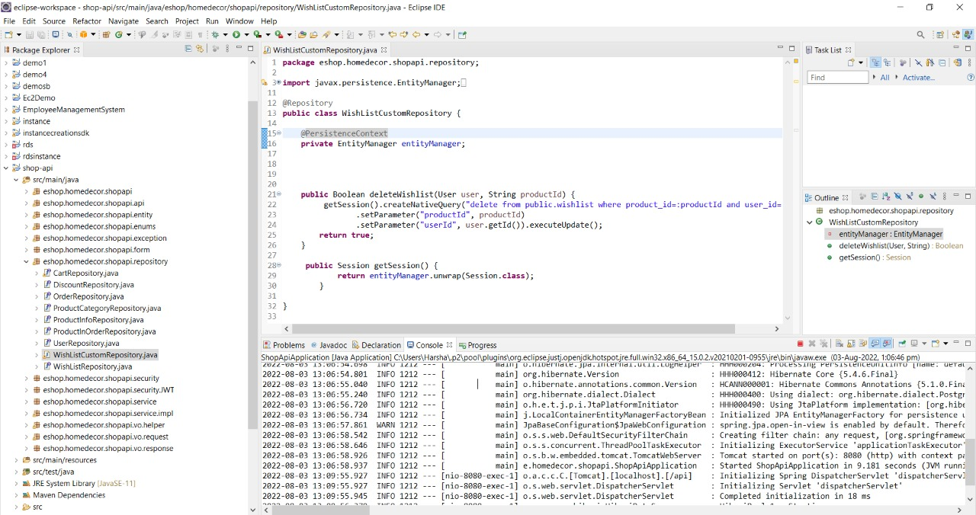
CREATING REPOSITORY

Slide 34
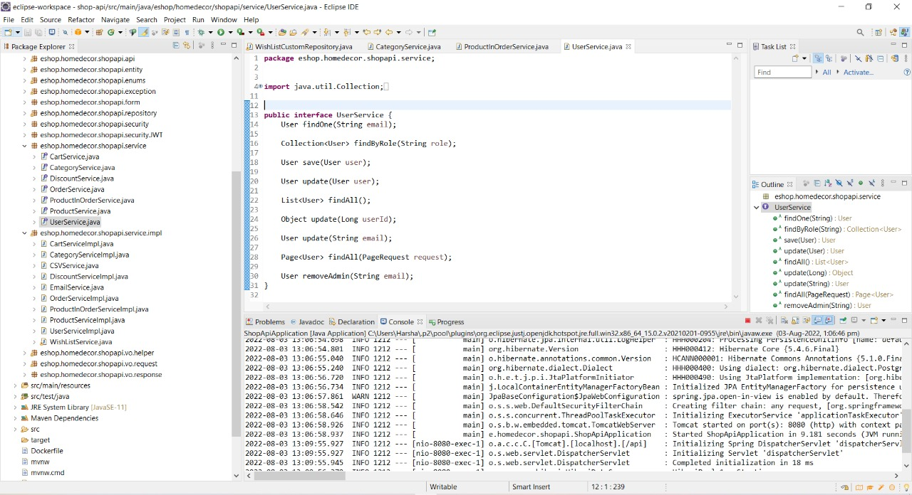
CREATING SERVICE LAYER LOGIC

Slide 35
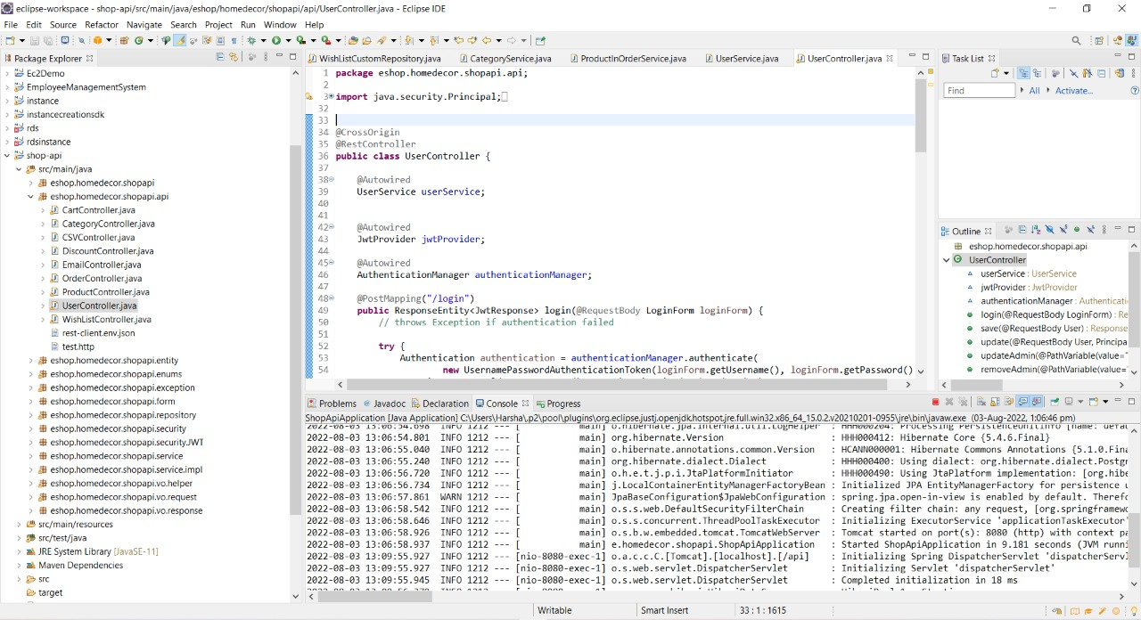
CREATING CONTROLLER TO DIRECT REST API

Slide 36
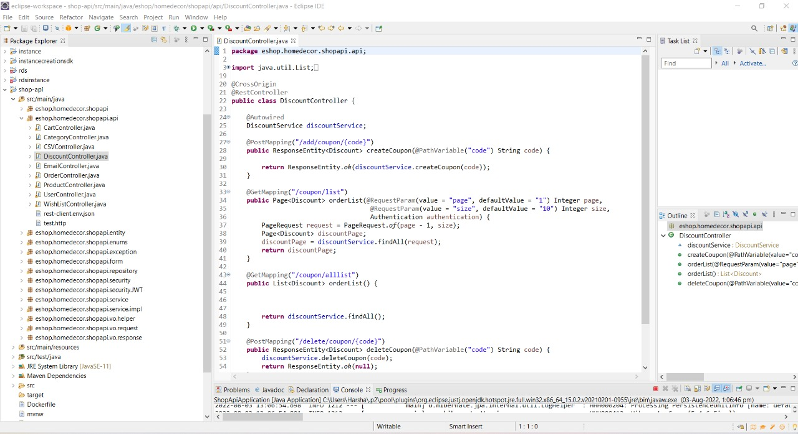
CREATE DISCOUNT MICROSERVICE

Slide 37


Slide 38
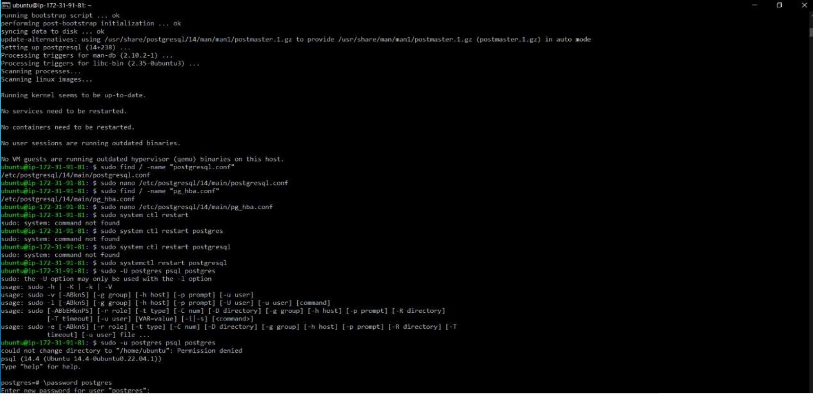
CLOUD DEPLOYEMENT- INSTALLING POSTGRESQL IN BACKEND INSTANCE
INSTALLING POSTGRESQL IN BACKEND INSTANCE

Slide 39
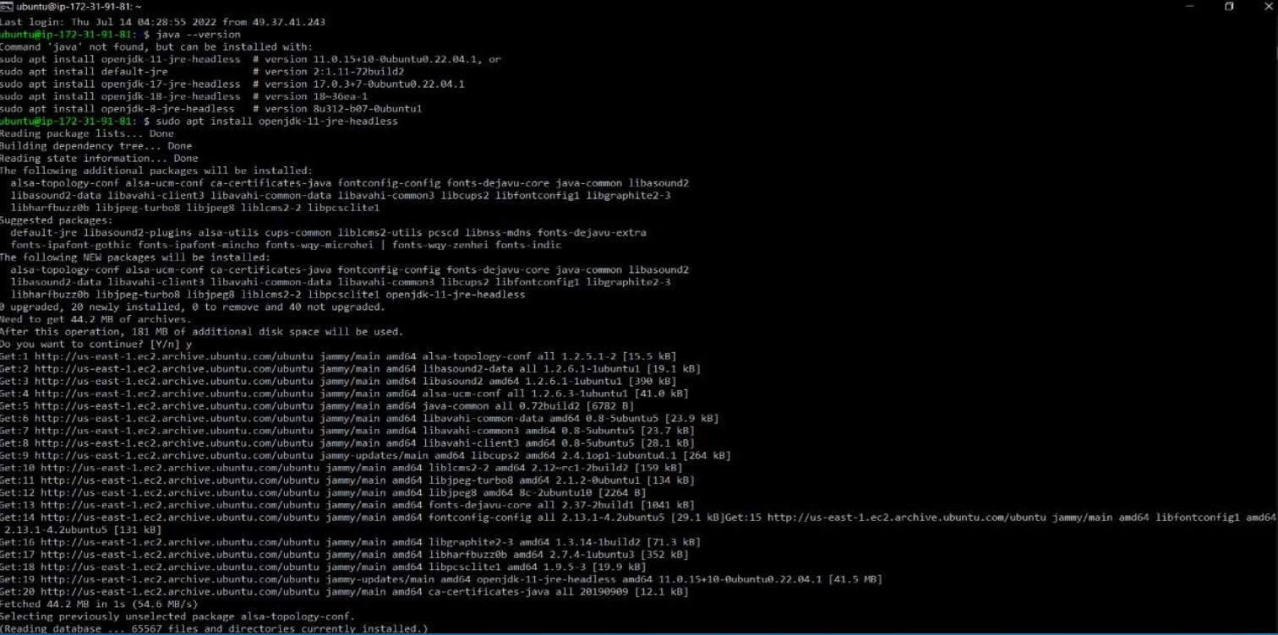
INSTALLING JDK IN BACKEND INSTANCE

Slide 40
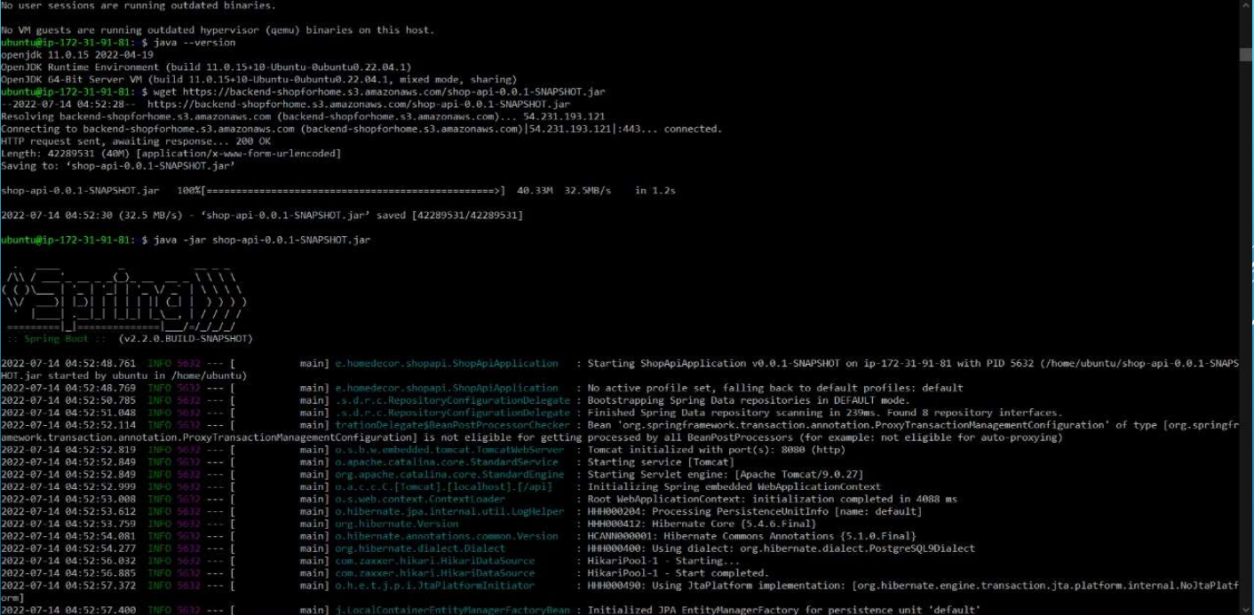
DEPLOYING SPRING BOOT BACKEND APPLICATION IN BACKEND INSTANCE

Slide 41
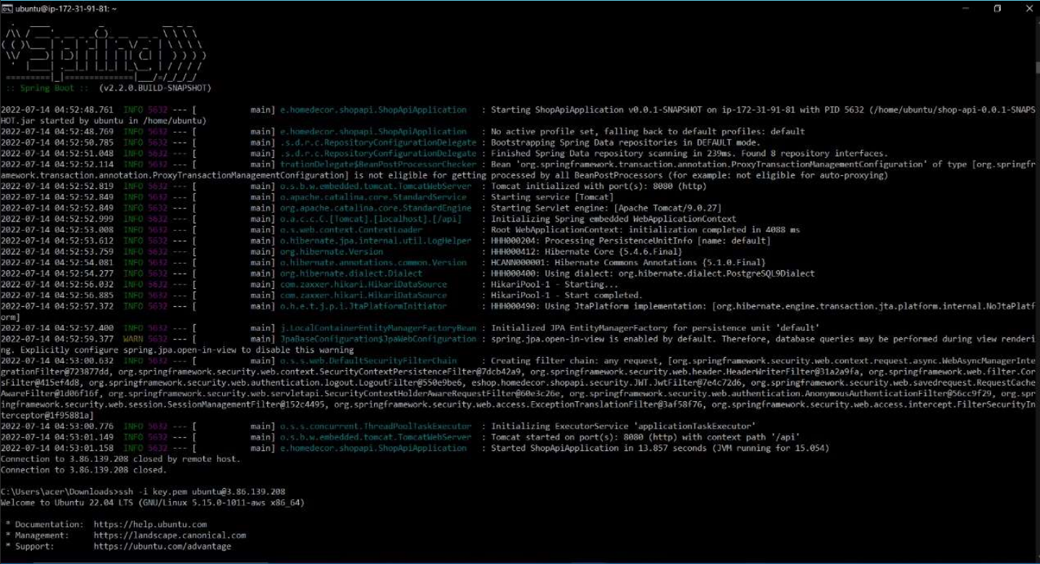

Slide 42
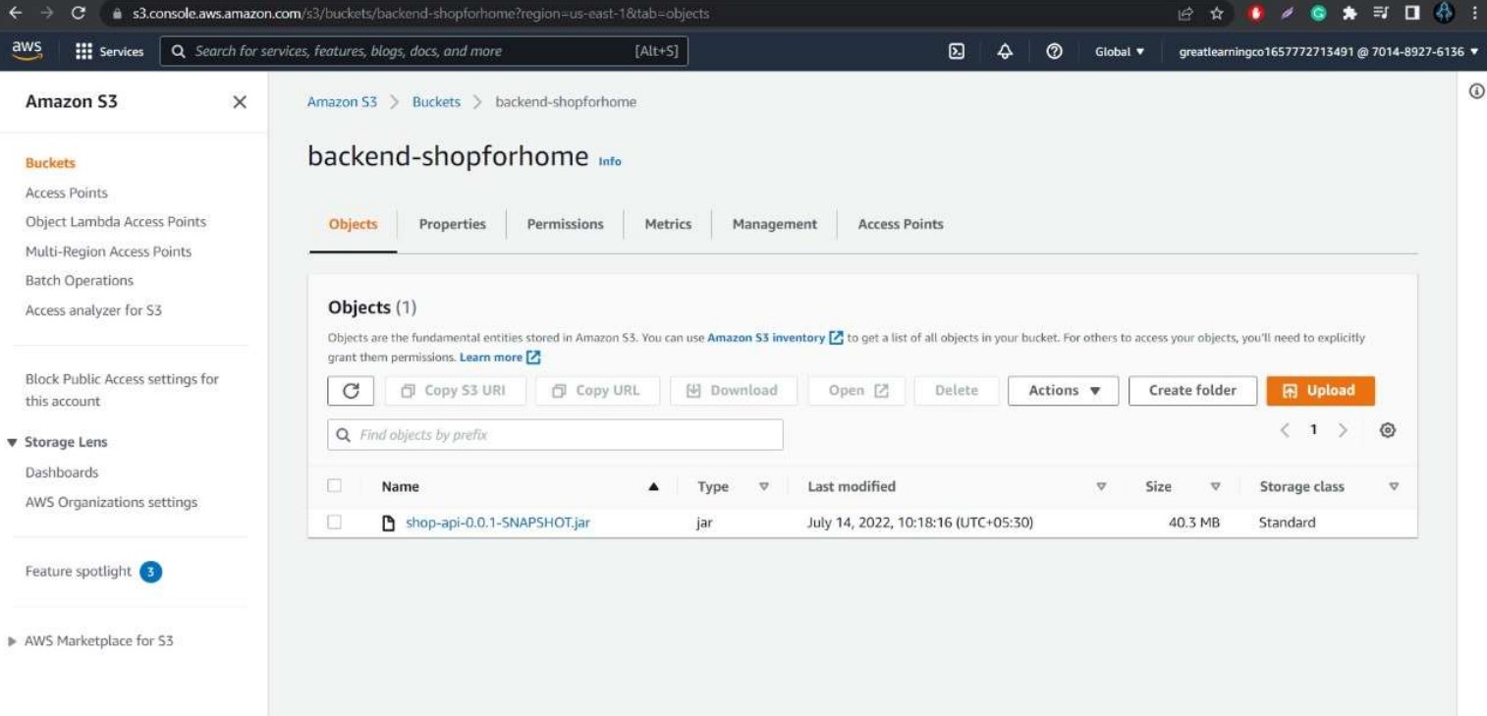
BACKEND JAR FILE IN S3 BUCKET

Slide 43
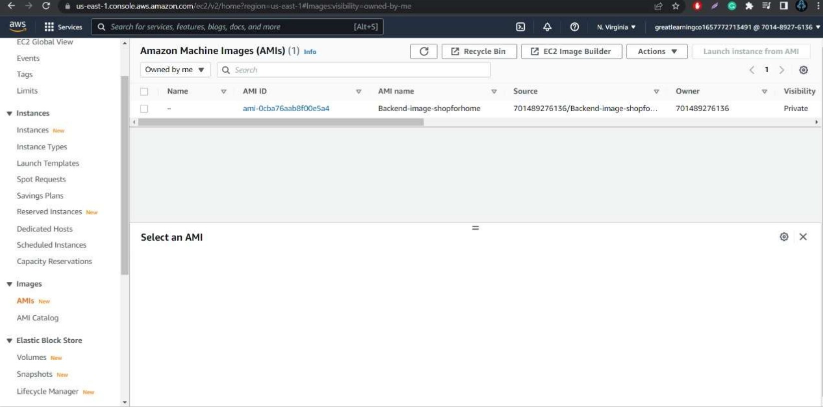
AMI CREATED FROM BACKEND INSTANCE TO USE IN AUTOSCALING

Slide 44
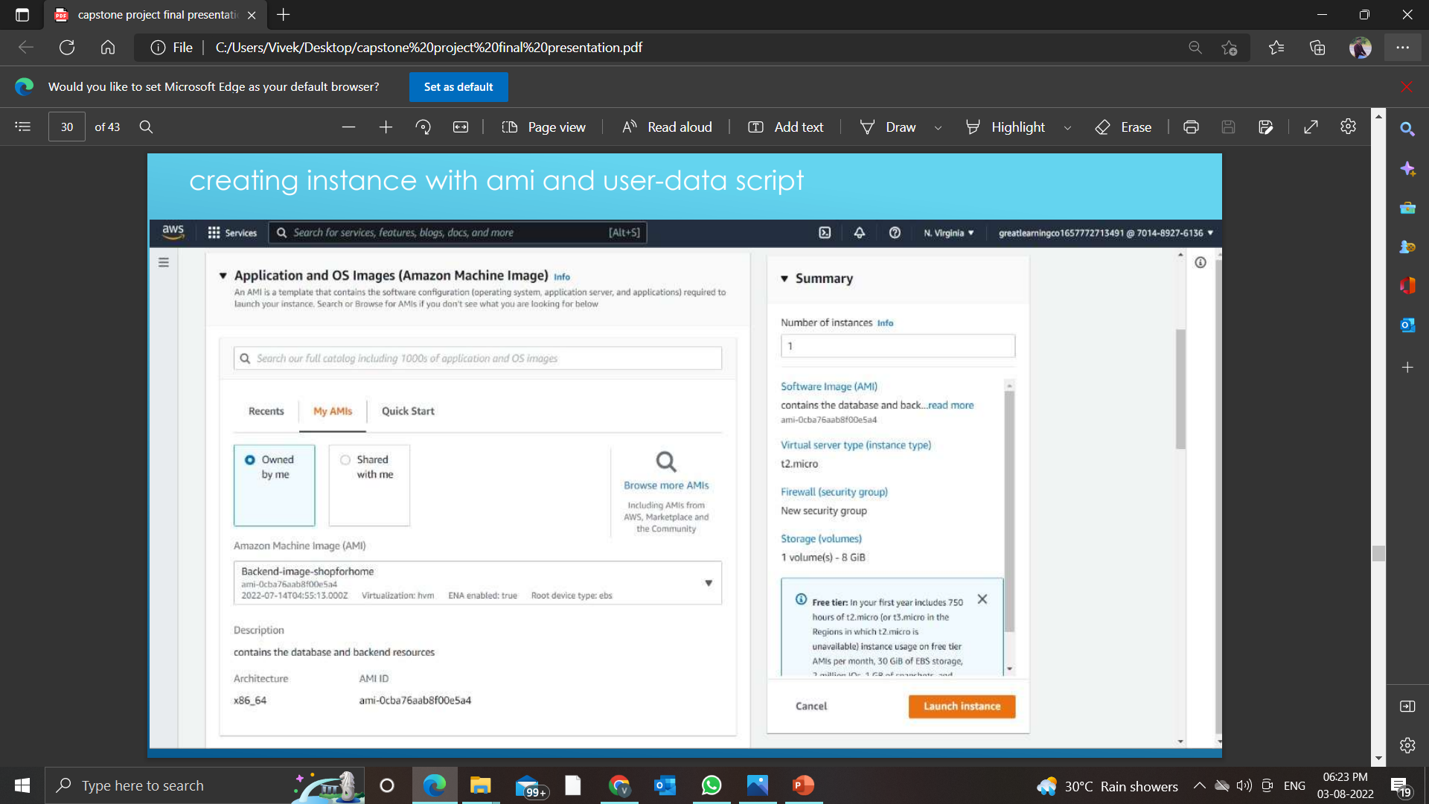
Creating instance with ami and user-data script

Slide 45
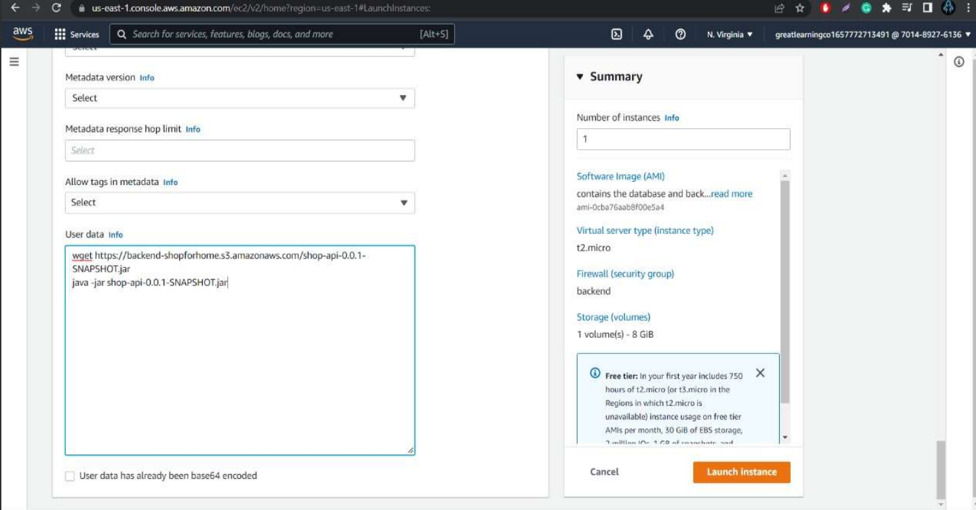

Slide 46
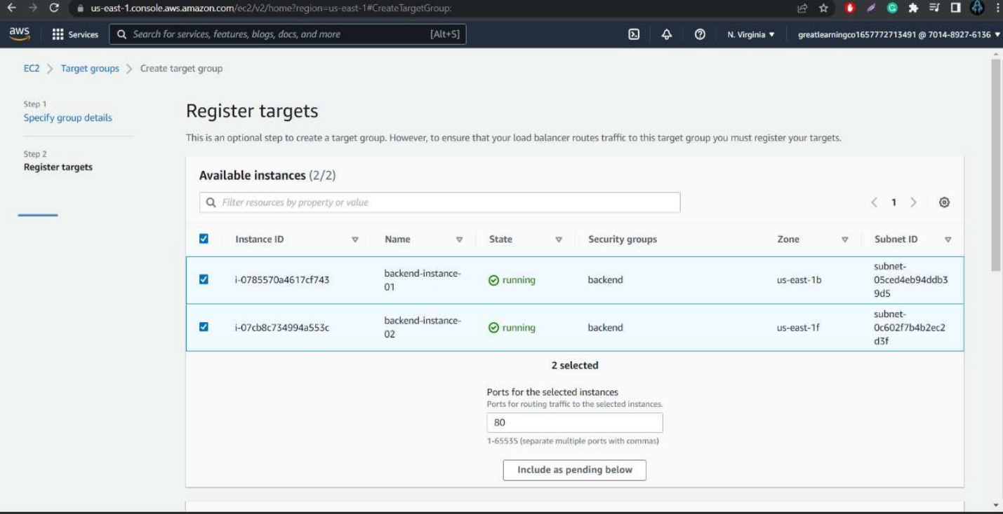
Creating target group

Slide 47
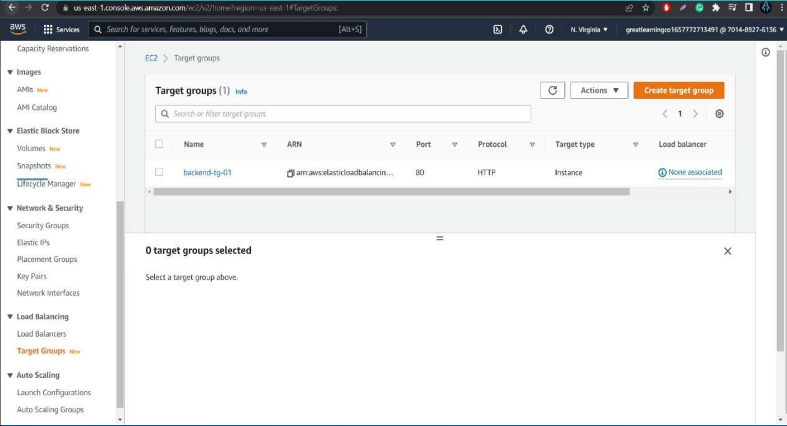

Slide 48
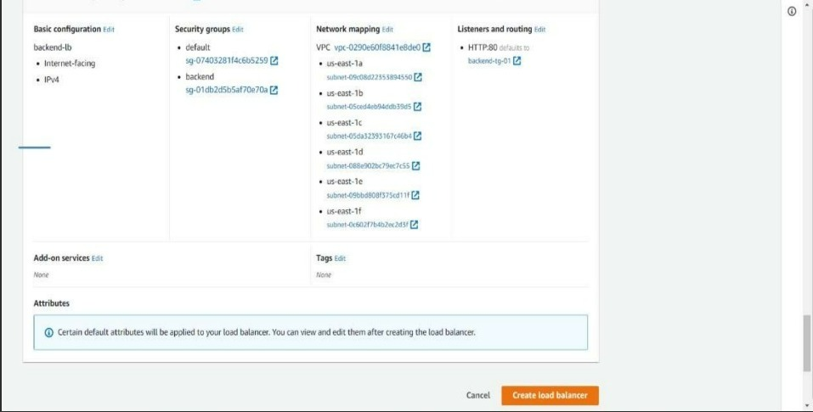
Creating load balancer

Slide 49
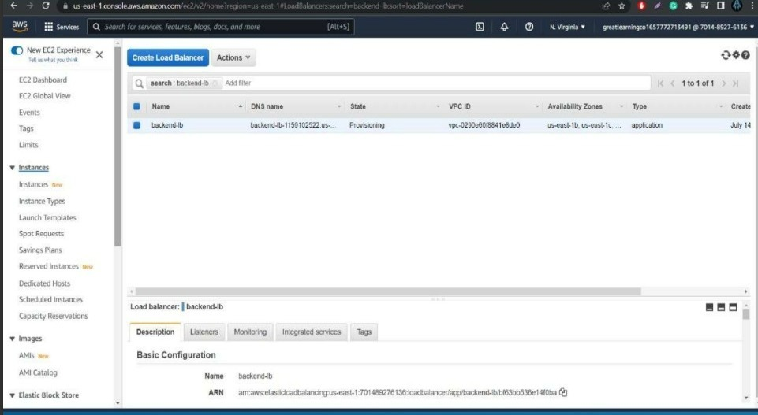

Slide 50
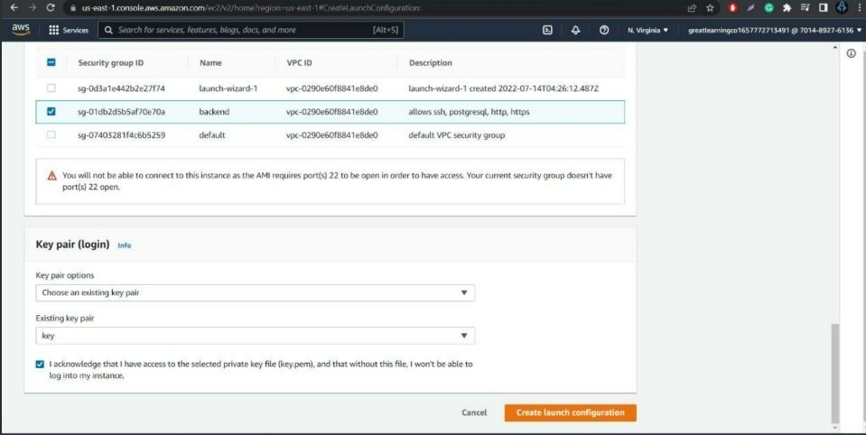
Creating launch configuration

Slide 51
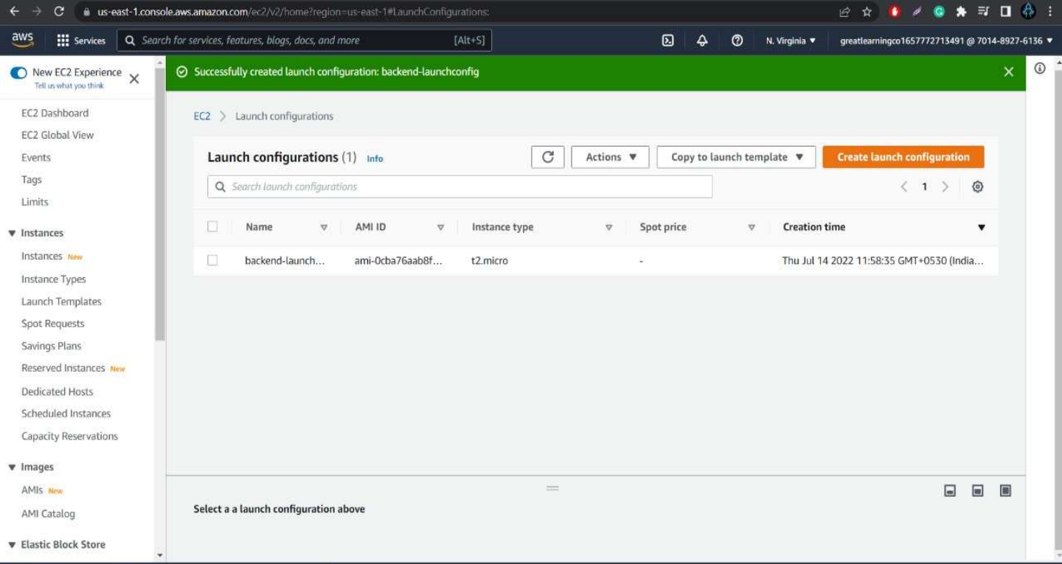

Slide 52
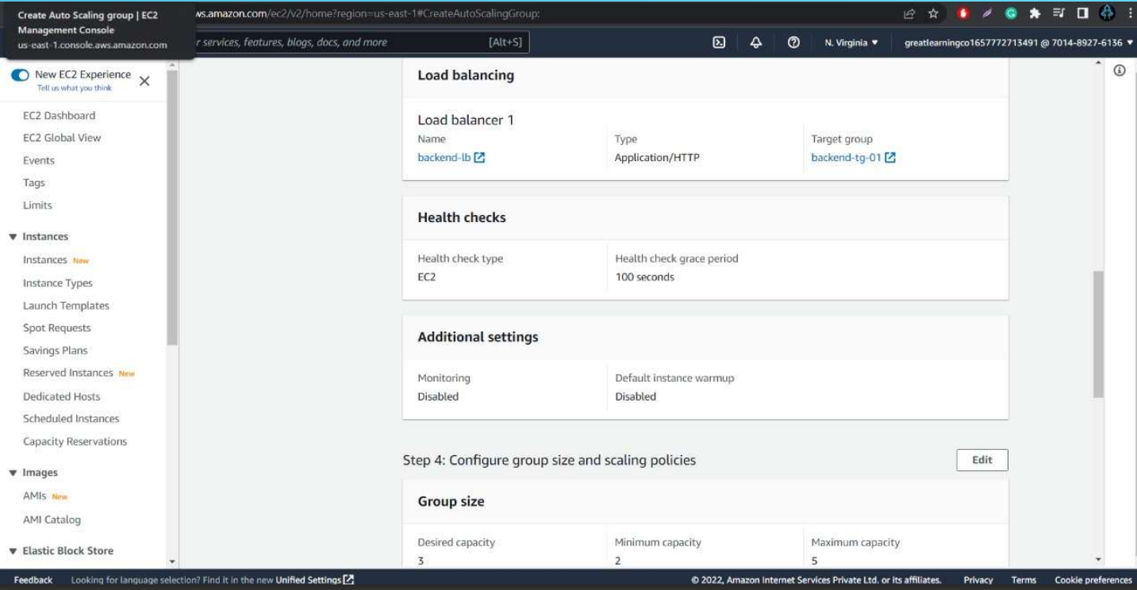
Creating auto-scaling group

Slide 53
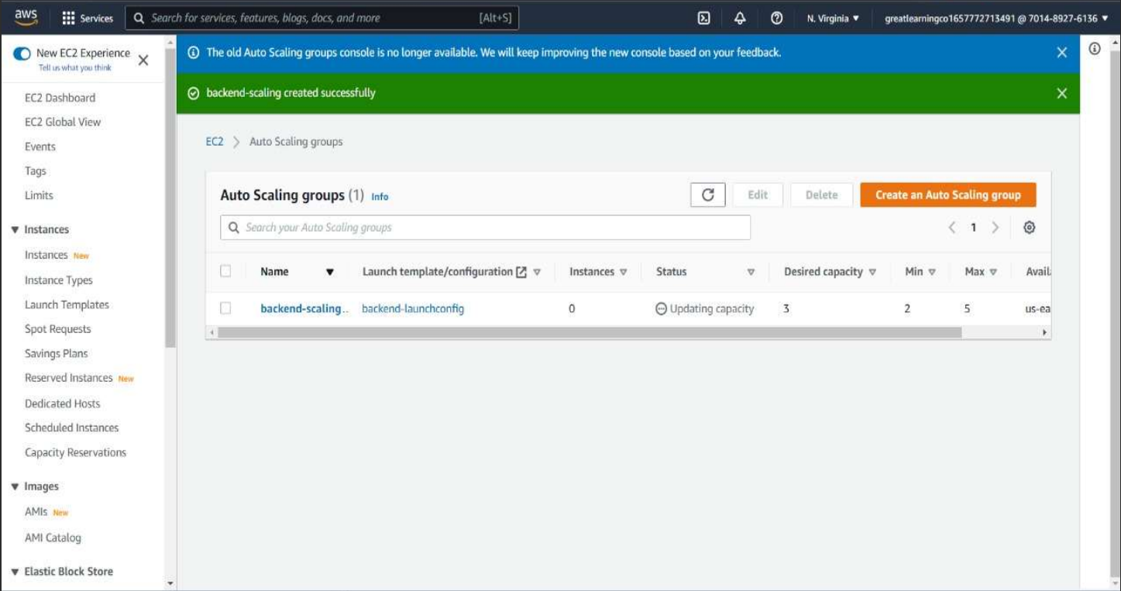

Slide 54
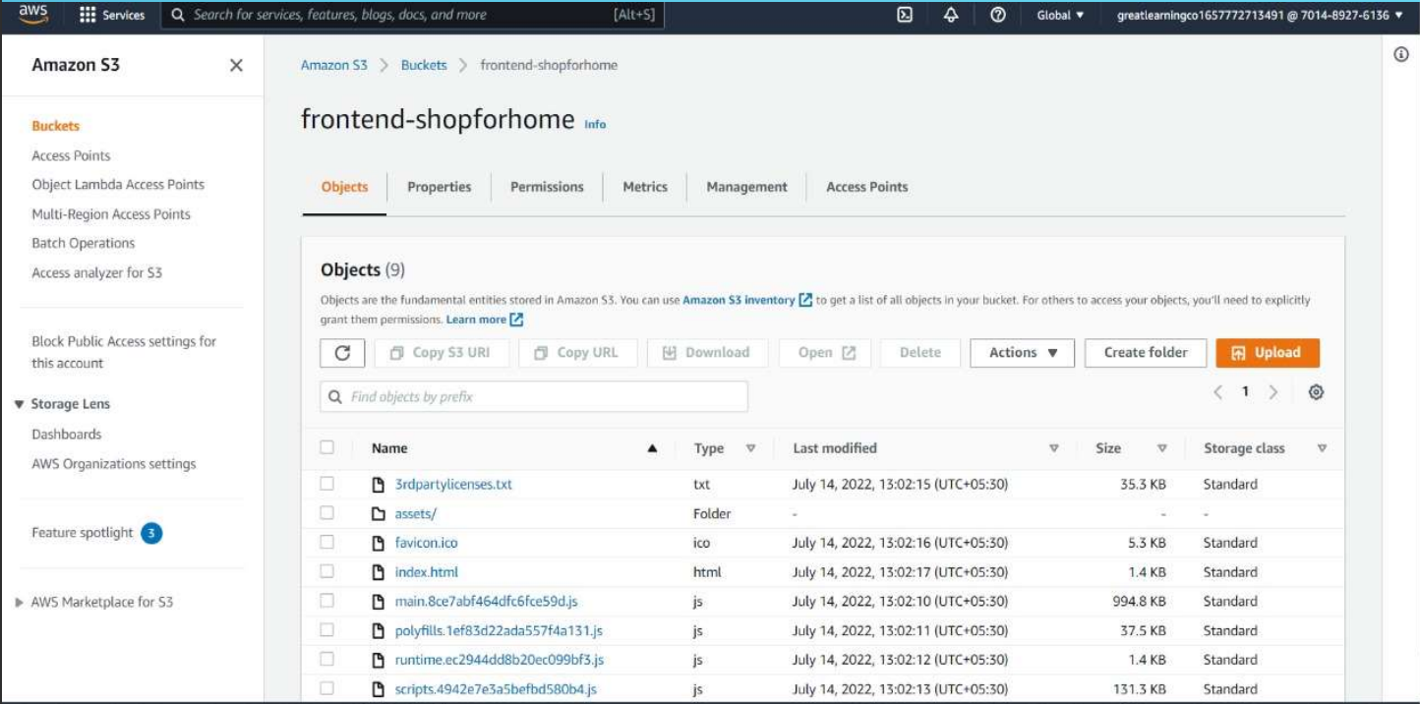
Creating frontend S3 bucket

Slide 55
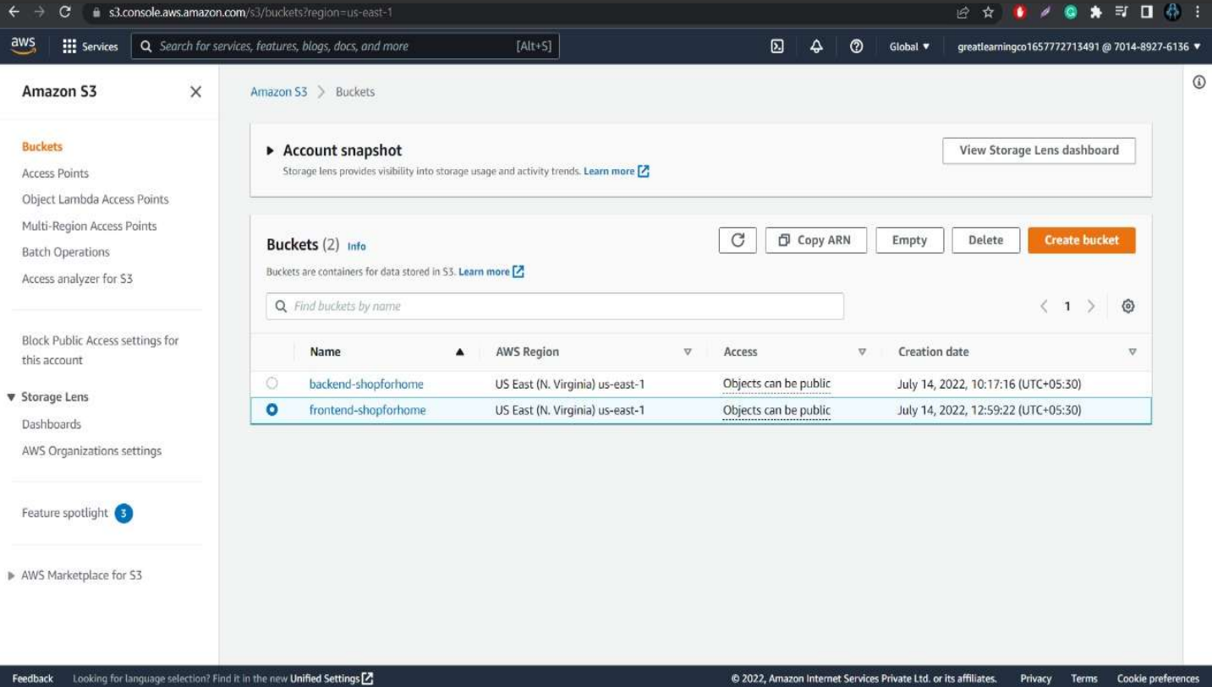

Slide 56
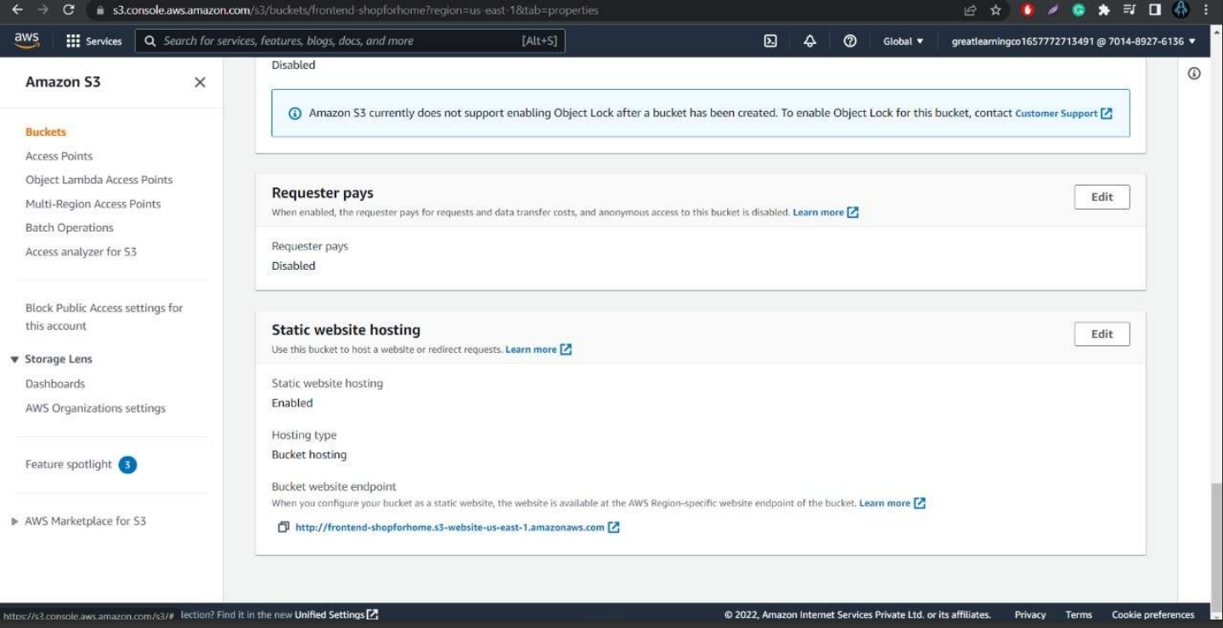
Static hosting frontend S3 bucket

Slide 57
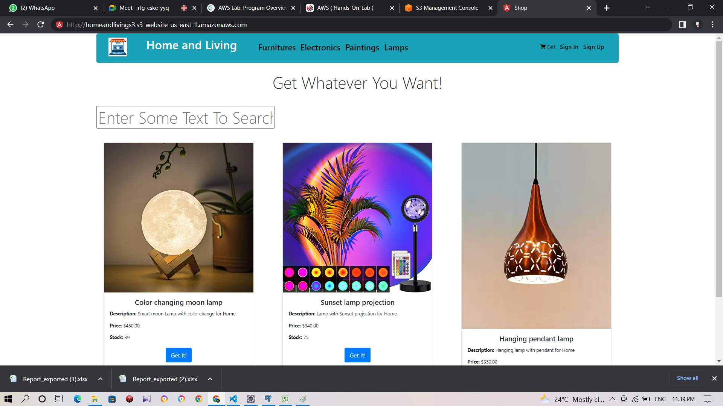

Slide 58
Thank you

